Slide 1
Digital Forensics

Slide 2
Learning Objectives
Students will be able to…
Define digital forensics and incident response process
Describe the scientific method, as applied to digital forensic
Describe the Daubert Standard and its five questions

Slide 3
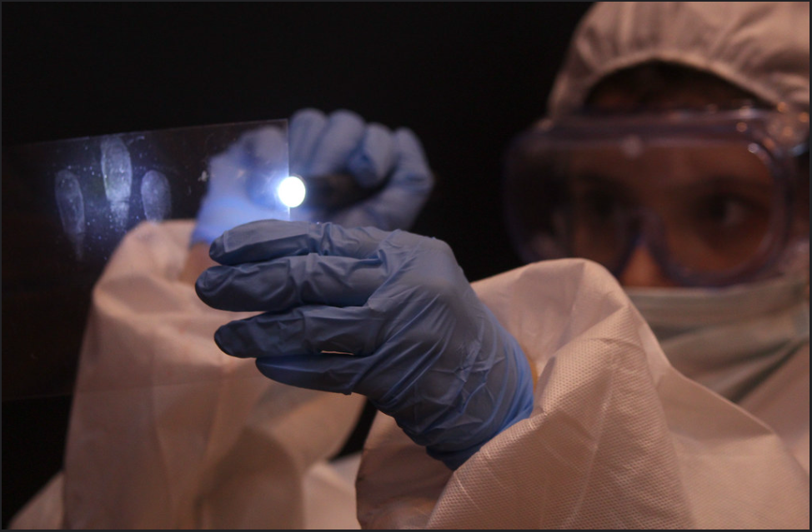
Forensic Science
applies scientific principles and methods to investigate crimes and legal matters.
Key areas of specialization:
DNA analysis
Fingerprint analysis
Toxicology
Ballistics
Digital forensics: Recovery and analysis of digital evidence from computers and other electronic devices.
Notes:
Additional sources: https://www.bluevoyant.com/knowledge-center/understanding-digital-forensics-process-techniques-and-tool
CC BY 2.0 DEED worldskillsteamuk https://www.flickr.com/photos/worldskillsteamuk/15797007232/in/photostream/

Slide 4
Scientific Method
Observe
Ask a question
Do background research
Form a hypothesis
Design an experiment or collect data
Analyze the data
Draw conclusions
Share your results, including to healthy sceptic

Slide 5
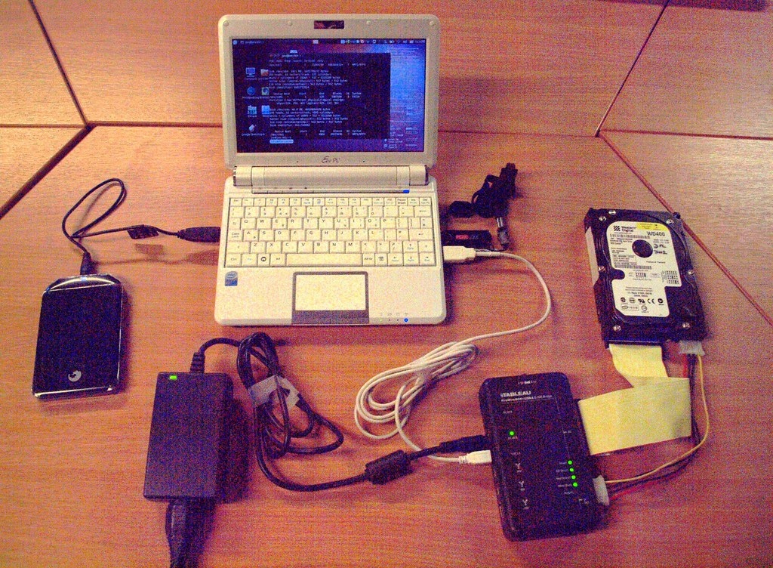
Digital Forensics
Identification, acquisition, preservation, analysis, and presentation of digital evidence.
gather evidence for legal investigations, criminal cases, civil lawsuits, and corporate investigations.
Part of an incident response process.
Not part of preventative strategy, used after the fact.
Incident response process: steps and tools used
to respond to a cybersecurity attack
Incident response plan: a predefined plan
outlining the incident response process.

Slide 6
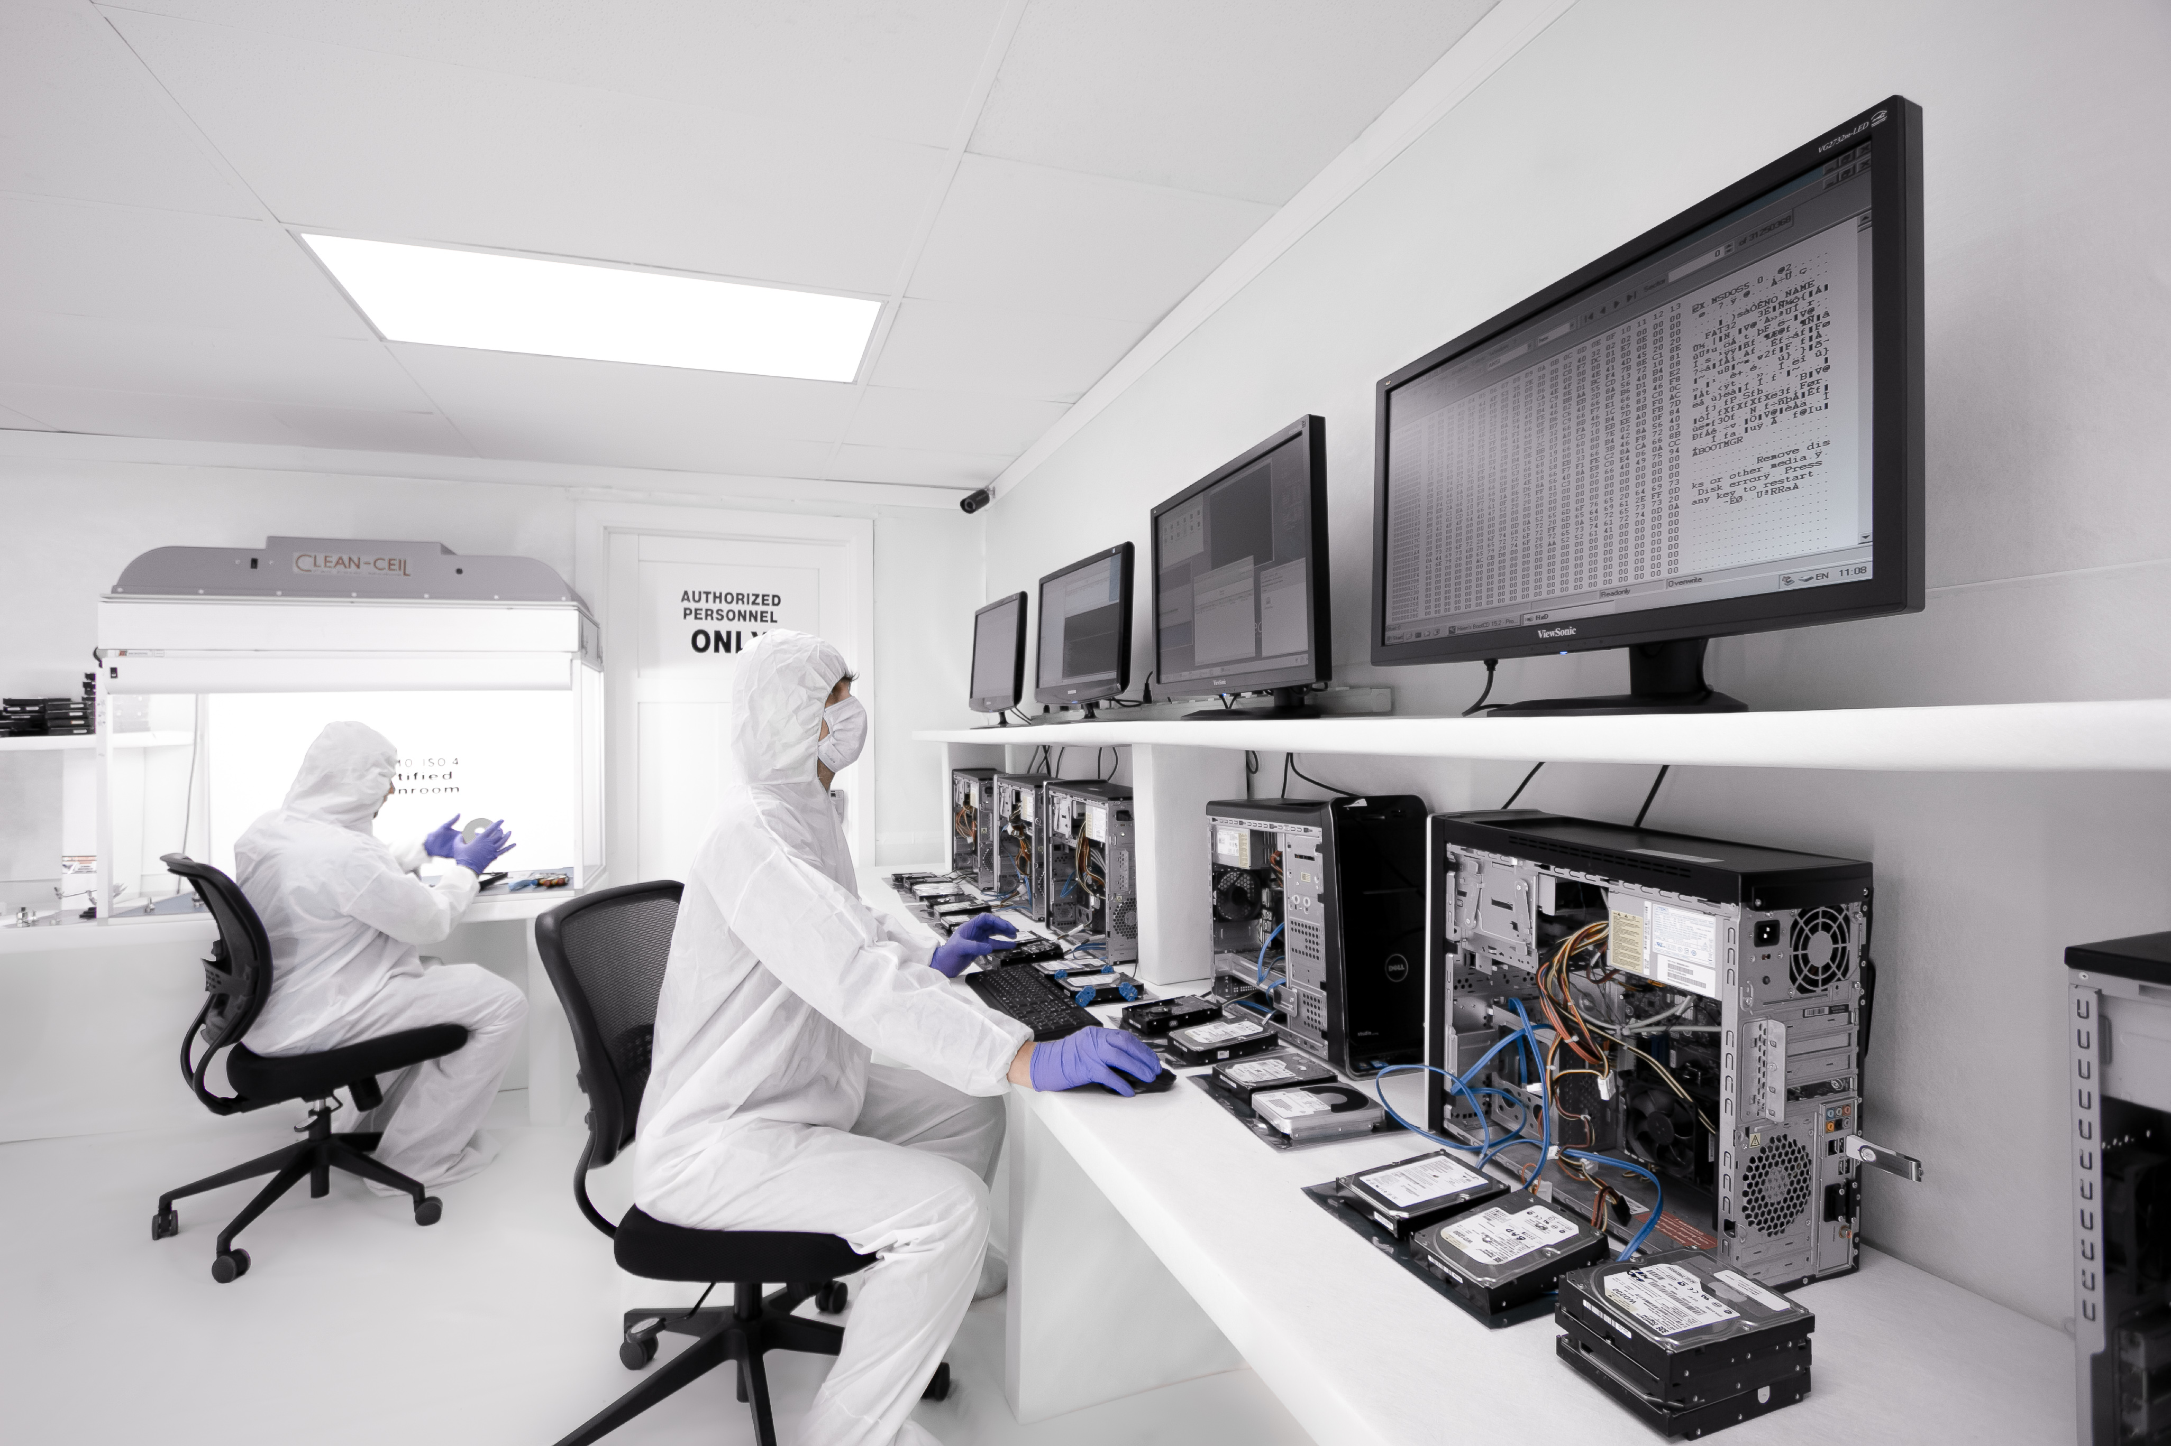
Application of Digital Forensics
Cybercrime (e.g., hacking, data breaches, online fraud)
Computer misuse (e.g., unauthorized access, data destruction)
Financial crimes (e.g., embezzlement, money laundering)
Intellectual property theft
Online child exploitation or human trafficking
Notes:
Image CC iktorDFC https://commons.wikimedia.org/wiki/File:Digital_forensics_lab.jpg

Slide 7
Scientific Method Example for Digital Forensics
Observe a cybersecurity attack
Ask a question: who is the attacker? What data was breached?
Do background research: gather computer logs, talk to employees
Form a hypothesis: attacker may have used phishing
Design an experiment or collect data. Look at computer logs and email repositories
Analyze the data, leverage statistics
Draw conclusions
Share your results. Get a healthy sceptic to challenge your conclusions. Then, write your results for corporate stakeholders or to law enforcement.

Slide 8
Daubert Standard
“The ‘Daubert Standard’ provides a systematic framework for a trial court judge to assess the reliability and relevance of expert witness testimony before it is presented to a jury. “ (Robinson, 2023)
1993 U.S. Supreme Court case Daubert v. Merrell Dow Pharmaceuticals Inc., 509 U.S. 579 (1993),
Trial judges to act as "gatekeepers" of scientific evidence
Notes:
Robinson, J. 2023 Aug. Daubert Standard. https://www.law.cornell.edu/wex/daubert_standard#:~:text=The%20Daubert%20case%20introduced%20a,pseudoscientific%20or%20unreliable%20expert%20testimony.

Slide 9
Daubert Standard Five Questions
Testing: Has the scientific procedure been independently tested?
Peer Review: Has the scientific procedure been published and subjected to peer review?
Error rate: Is there a known error rate, or potential to know the error rate, associated with the use of the scientific procedure?
Standards: Are there standards and protocols for the execution of the methodology of the scientific procedure?
Acceptance: Is the scientific procedure generally accepted by the relevant scientific community? (Garrie & Morrissy, 2014)
Notes:
Daniel B. Garrie and J. David Morrissy, Digital Forensic Evidence in the Courtroom: Understanding Content and Quality, 12 Nw. J. Tech. & Intell. Prop. 121 (2014). https://scholarlycommons.law.northwestern.edu/njtip/vol12/iss2/5
https://scholarlycommons.law.northwestern.edu/cgi/viewcontent.cgi?article=1218&context=njtip#:~:text=The%20Daubert%20standard%20applies%20to,and%20subjected%20to%20peer%20review%3F

Slide 10
Wrap Up
Digital forensics is the identification, acquisition, preservation, analysis, and presentation of digital evidence.
Uses the scientific method
Primary used for law enforcement and court evidence
Daubert Standard has five questions to satisfy for admissibility in court
Not a preventative strategy

